Slide 1
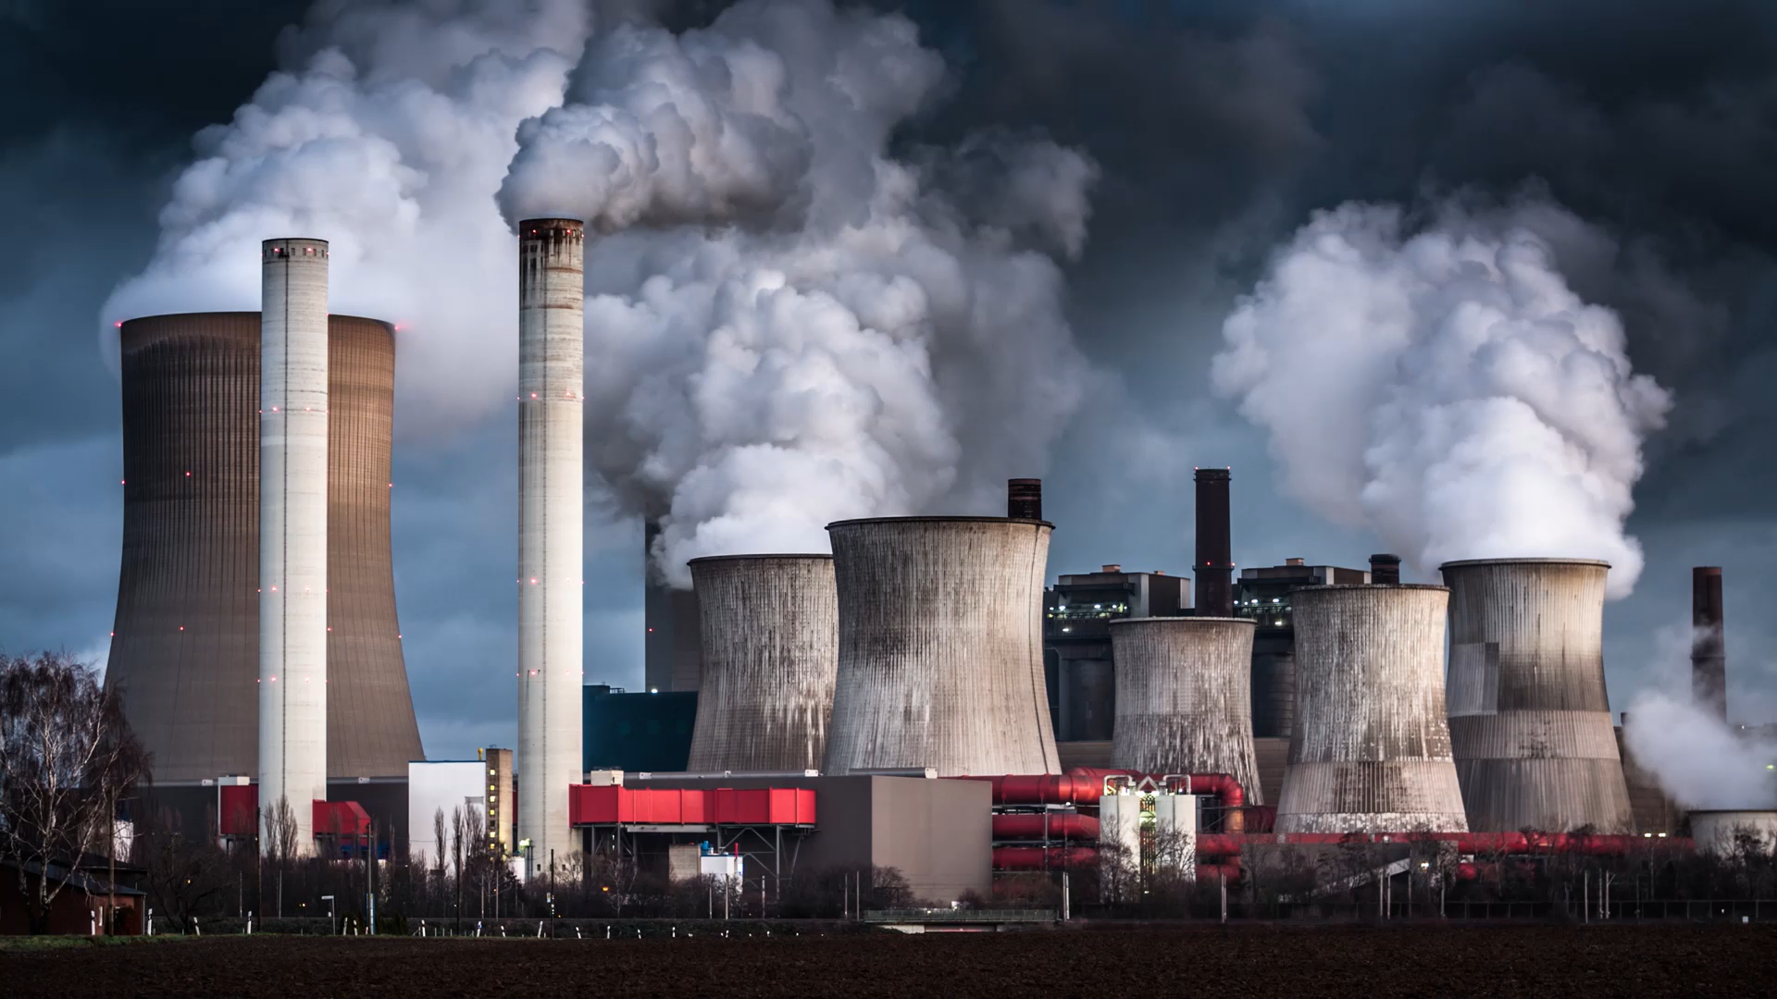
Energy Industry Projections
Ryan Reiser

Slide 2
Data Collection & Expected Signs of Variables
Dependent Variables:
Yearly Global Fossil Fuel Energy Consumption (TWh)
Yearly Global Renewable Energy Consumption (TWh)
Independent Variables:
Yearly World GDP (USD) (+) (+)
Yearly Crude Oil Prices (USD) (-) (+)
Yearly Global Tertiary Education Enrollments (+) (+)
Yearly Global Nuclear Powerplants Built (-) (+)
Environmentalism Movement (Dummy Variable for Year > 2007) (-) (+)

Slide 3
Generate Log Differences of Variables
Approximates growth rates
Reduces heteroskedasticity
Reduces multicollinearity
Prevents trending relationships from inflating results (spurious correlations)
"How much did a variable change in percentage from one year to the next?"

Slide 4
Empirical Models
dln_FossilFuelTotal_{t} = β₀ + β₁ * dln_WorldGDP_{t} + β₂ * dln_CrudeOilPrice + β₃ * dln_TeriaryEnrollment_{t} + β₄ * dln_NuclearPlants + β₅ * EnviroDummy + ε_{t}
dln_RenewableTotal_{t} = β₀ + β₁ * dln_WorldGDP_{t} + β₂ * dln_CrudeOilPrice + β₃ * dln_TeriaryEnrollment_{t} + β₄ * dln_NuclearPlants + β₅ * EnviroDummy + ε_{t}

Slide 5
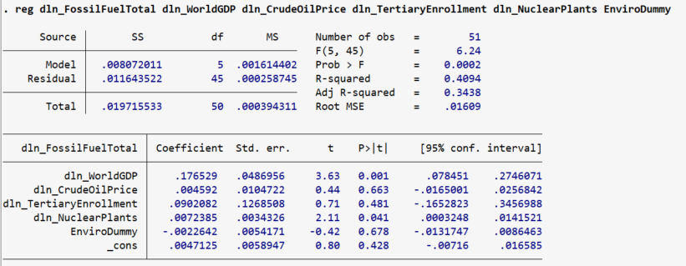
Predicting Fossil Fuel Energy Consumption
Model explains 34.38% of variation within fossil fuel based energy consumption
Statistically Significant Variables: WorldGDP & Nuclear Plants Built (+?)
Surprising to see Crude Oil have a low impact and positive coefficient

Slide 6
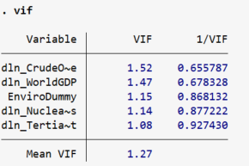
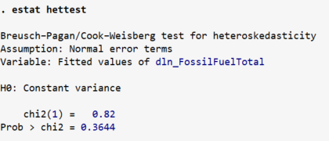
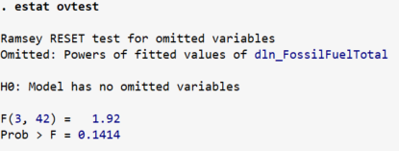
Further Testing
Variance Inflation Factor Test Heteroskedasticity Test Omitted Variable Test
No signs of significant multicollinearity, heteroskedasticity, or omitted variables

Slide 7
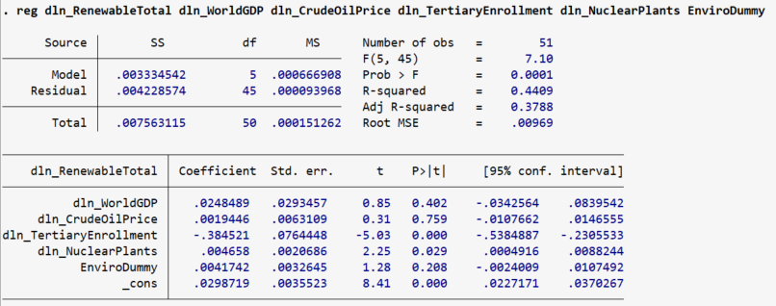
Predicting Renewable Energy Consumption
Marginally better results than the fossil fuel regression
Model explains 37.88% of variation within renewable energy consumption
Statistically Significant Variables: Tertiary Education Enrollments (-?) & Nuclear Plants Built

Slide 8
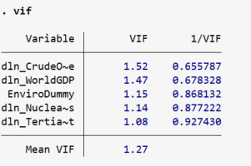
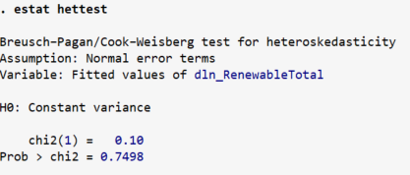
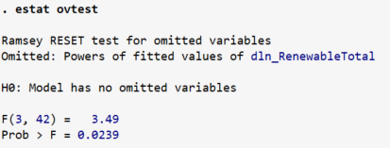
Further Testing (again)
Variance Inflation Factor Test Heteroskedasticity Test Omitted Variable Test
No signs of significant multicollinearity, heteroskedasticity, or omitted variables

Slide 9

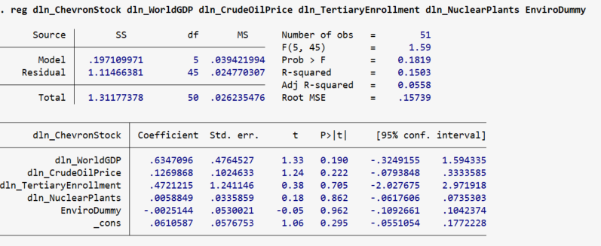
Why does this matter to business majors?
Model explains 0.056% of variation within Chevron stock
Statistically Significant Variables: None ☹

Slide 10
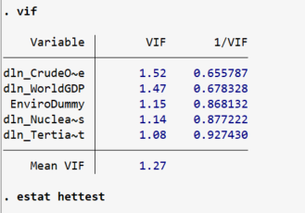
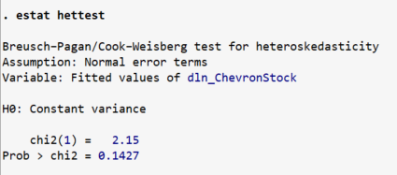
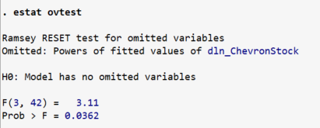
Further Testing (again, again)
Variance Inflation Factor Test Heteroskedasticity Test Omitted Variable Test
No signs of significant multicollinearity, heteroskedasticity, or omitted variables

Slide 11

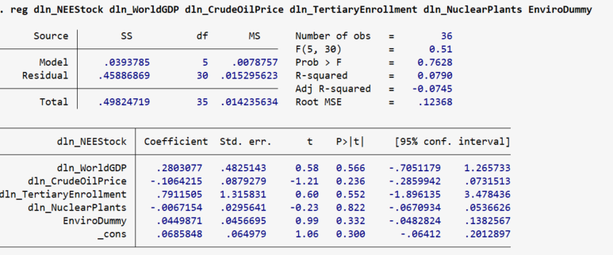
One final regression!
Model explains… less than nothing?
Statistically Significant Variables: None ☹

Slide 12
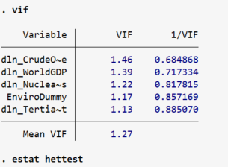
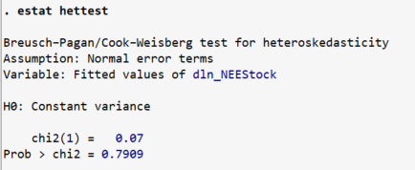
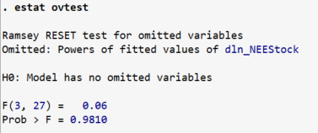
Further Testing (again, again, again)
Variance Inflation Factor Test Heteroskedasticity Test Omitted Variable Test
No signs of significant multicollinearity, heteroskedasticity, or omitted variables

Slide 13
Thank you!
Data Source Citations
https://www.macrotrends.net/stocks/charts/NEE/nextera-energy/stock-price-history
https://www.macrotrends.net/stocks/charts/CVX/chevron/stock-price-history
https://inflationdata.com/articles/inflation-adjusted-prices/historical-crude-oil-prices-table/
https://globalenergymonitor.org/projects/global-nuclear-power-tracker
https://ourworldindata.org/fossil-fuels
https://ourworldindata.org/renewable-energy
https://ourworldindata.org/global-education
https://data.worldbank.org/indicator/NY.GDP.MKTP.CD?end=2023&start=1960

